Slide 1
Webex Contact Center Admin/Supervisor Training

Slide 2
Agenda
Service overview
Provisioning
Dashboard and Additional features
Advanced Provisioning
Questions?

Slide 3
Webex Contact Center Service Overview

Slide 4
What does Webex Contact Center do?
For the caller
Call routing based on menu prompts and selections
Call queuing and distribution
For the agent
Call management (hold, consult, conference and transfer)
Make calls (out)
Agent state management (available, break, etc.)
Personal statistics
For the system administrators
ACD administration
Access control rights
Agent provisioning
For the management team (including QA)
Call monitoring
Call recording
Real-time reports
Historical reports

Slide 5
Provisioning

Slide 6











Webex Contact Center Provisioning Framework
Customer Calls
Call Routing Resources
Control Scripts
Entry Point Strategies
Wave Files
Wave Files
Queue Strategies
Wave Files
Call Handling Resources
SITE X
SITE Y
Agent Profiles
Team 1
Team 2
Team 3
Address Books
Agents
Agents
Agents
Agents
Agents
Agents
Agents
Skill Profiles

Slide 7
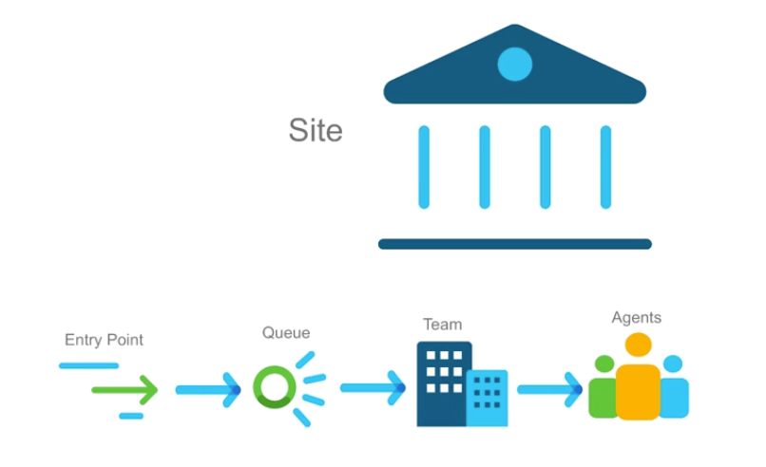
Basics
An ‘Entry Point’ is the initial landing place for customer call
A ‘Queue’ is where active calls are stored before being connected to Teams and Agents
A ‘Team’ is a group of Agents at a specific site who handles calls
An ‘Agent’ is the person at the end of the call flow who is handling the call
A ‘Site is a physical Contact Centre location under control of the Tenant.
Teams shall be provisioned under Sites. Sites are not used for Routing Strategies but they can be used to run specific reports.
Every single inbound call will consist of at least one Entry Point and one Queue

Slide 8
Teams
Calls in queues are distributed to teams
calls in a specific queue can be routed to one or more teams
queue routing strategy determines which the grouping, order, and timing of team distribution
calls can be distributed to agents in a team based on longest available, skills based, load based or priority based.
Types
agent-based
composed of agents who select that team when logging in to the phone console
when an agent is selected, a call is placed to the phone number he or she entered at the log in
an agent can only log into one team at a time
capacity-based
each capacity-based team has an associated phone number
when a capacity-based team is selected, a call is placed to that phone number
calls in excess of the specified capacity for the team will be queued

Slide 9
Provisioning – Call Handling & Management
create/edit call handling resources
Sites
Teams
Agents
Agent Profiles
Address Books
Auxiliary Codes for Agent Profiles
Idle Codes
Wrap Codes
Skill Definitions
Skill Profiles
create/edit call management resources
Create Entry Points and Queues
Manage DID/TFN to Entry Point mapping
Create Routing Strategies
Control scripts (.js & .php)
Music & Message files (.WAV)

Slide 10
Provisioning – Add/Delete Users
Must be done in Control Hub
Will synchronize to the WxCC admin portal
Inside the Admin portal
User profile and agent profile can be modified as well as assignment of team and any skill profile
Deleting users must happen in control hub
After deleting the user, the system will put that user in “InActive” status

Slide 11
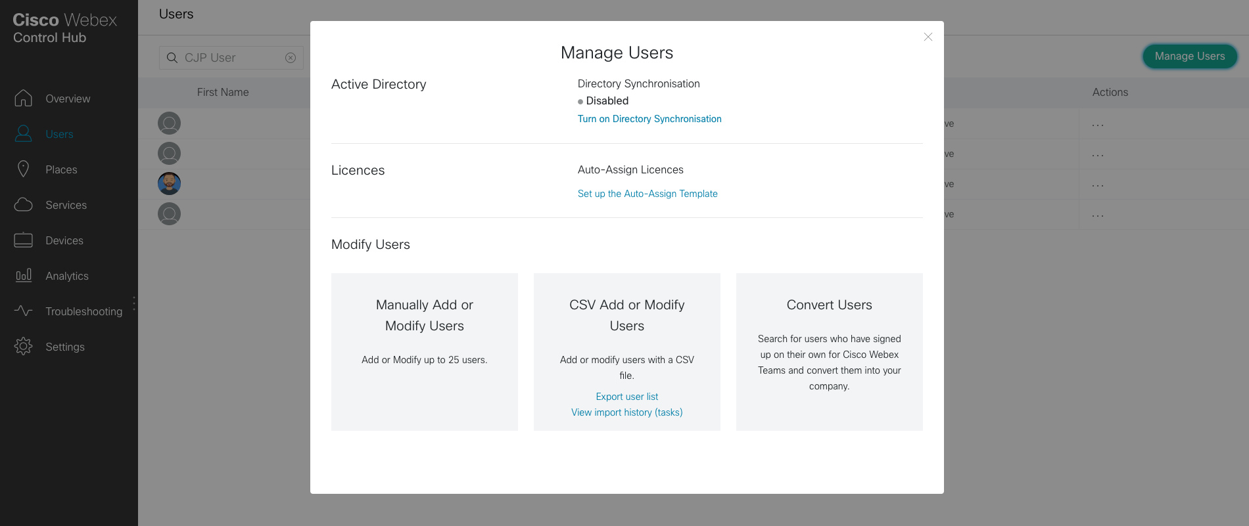
User Enrolment
Manually: add users mail
Bulk: Upload CSV files with data and services
Convert: Users signed up for Webex Teams trial
*WCC does not support Active Directory Sync as of today

Slide 12

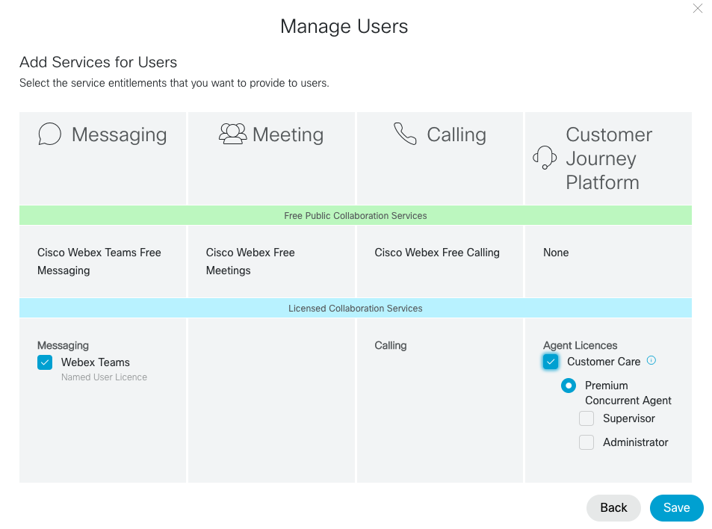
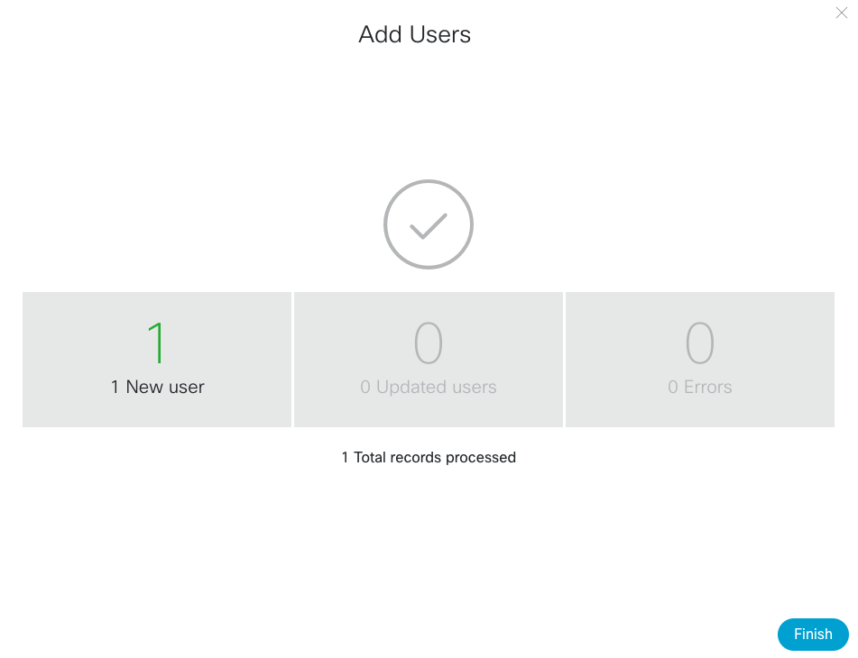
User Enrollment
Webex Teams service needs to be enabled because chat feature uses the Webex Teams Infrastructure
Select the appropriate agent license under ‘Customer Journey Platform’ card
Select ‘Finish’

Slide 13
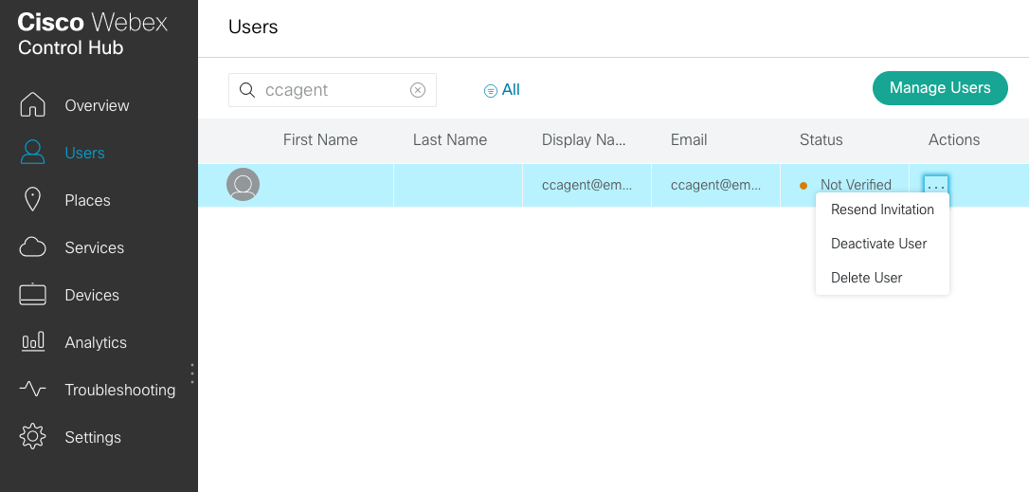
User Enrollment
User Status will be ‘Not Verified’ until end user verification/activation is completed
Customer admin has an option to resend the invitation
Customer admin also has the option to deactivate or delete the user in this status

Slide 14
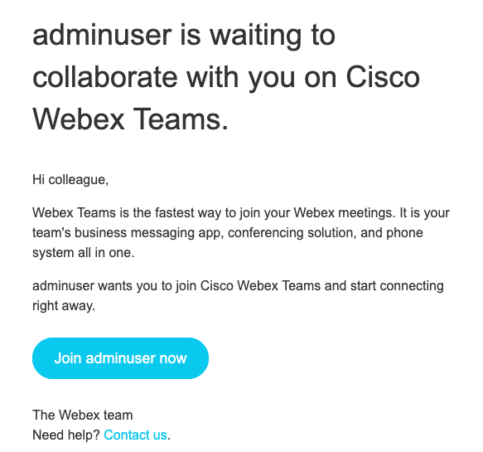
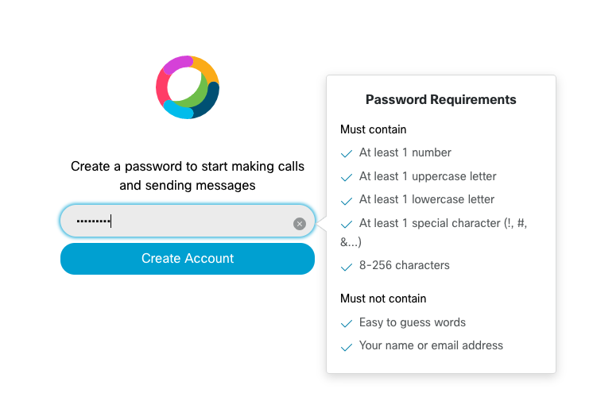
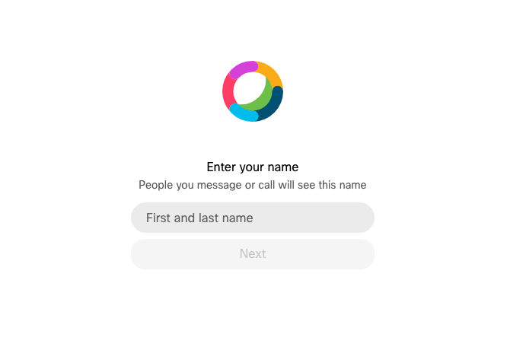
User Enrollment
End customer to complete enrollment using the activation link received in mail.
Set password as per requirements
Set First and last Name and select ‘Next’

Slide 15
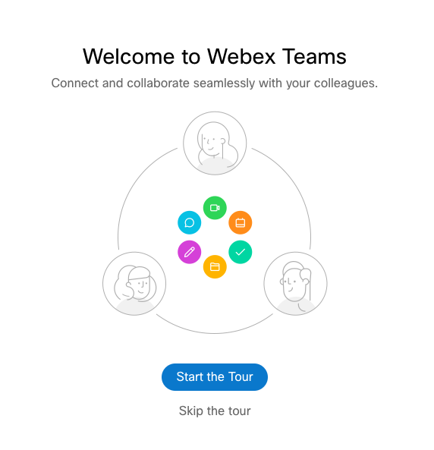
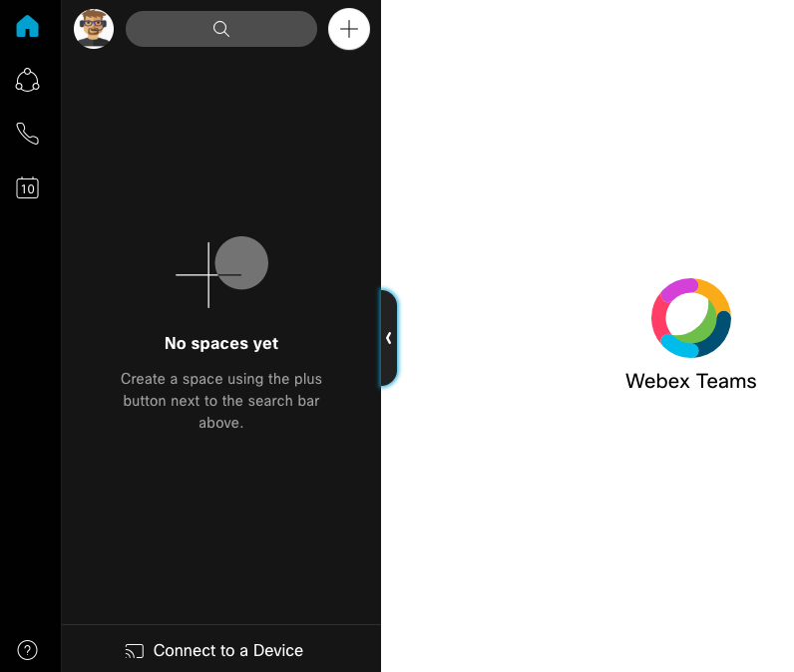
User Enrollment
End user enrollment is complete with this step

Slide 16
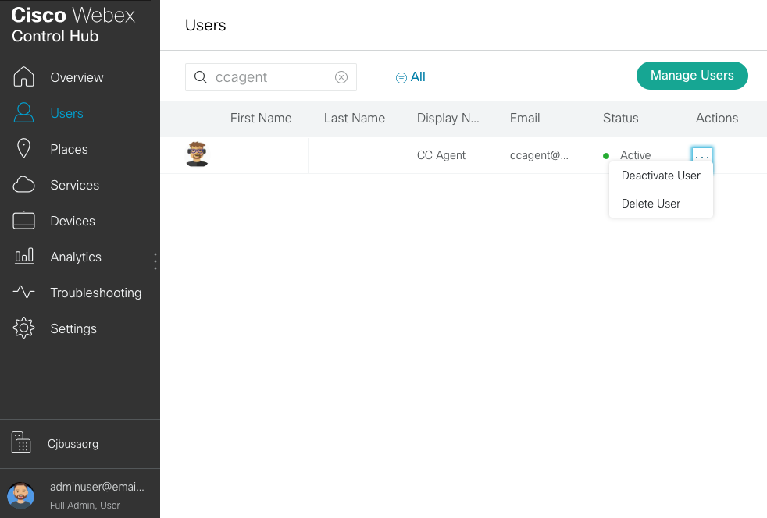
User Enrollment
User Status will change to ‘Active’ since the user verification/activation is completed
Customer admin has an option to resend the invitation
Customer admin also has the option to deactivate or delete the user in this status

Slide 17
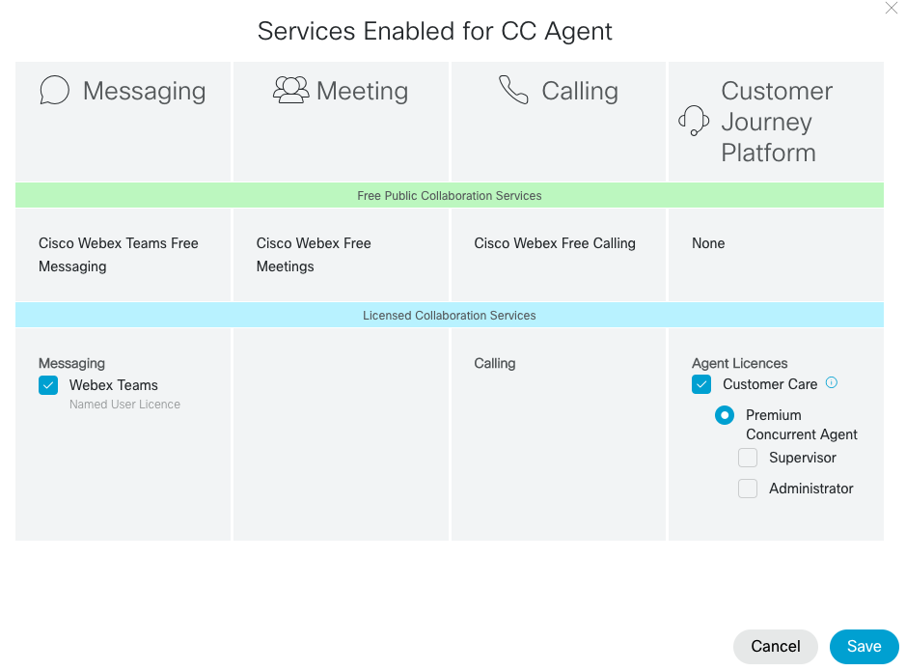
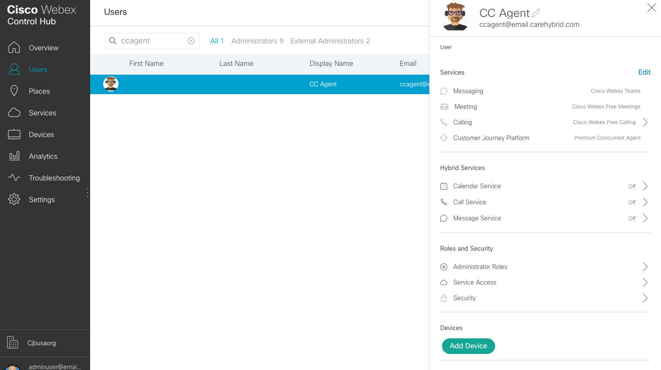
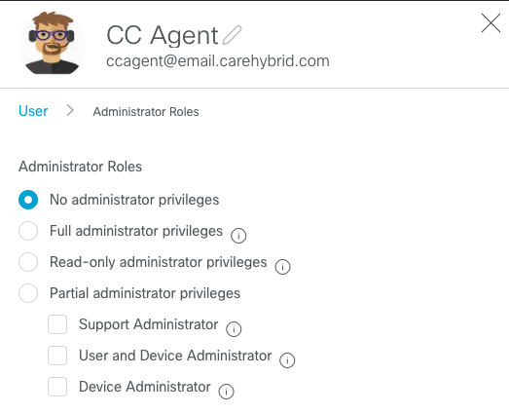
User Enrollment
Select ‘Edit’ under services to change CJP services for a user
Roles & Responsibilities – CI does not send entitlement change notifications to CJP as of today. TM WIP in regards to this.

Slide 18
Provisioning – User Profiles
User Profiles
Defines the users level of access within the application for each module
The system supports several types of profiles
Agent, Administrative, Supervisor
By default the system will set up Admin,Supervisor, Premium Agent and Standard Agent Profile
Different types of supervisor profiles can be created
Profiles are then assigned to each user

Slide 19
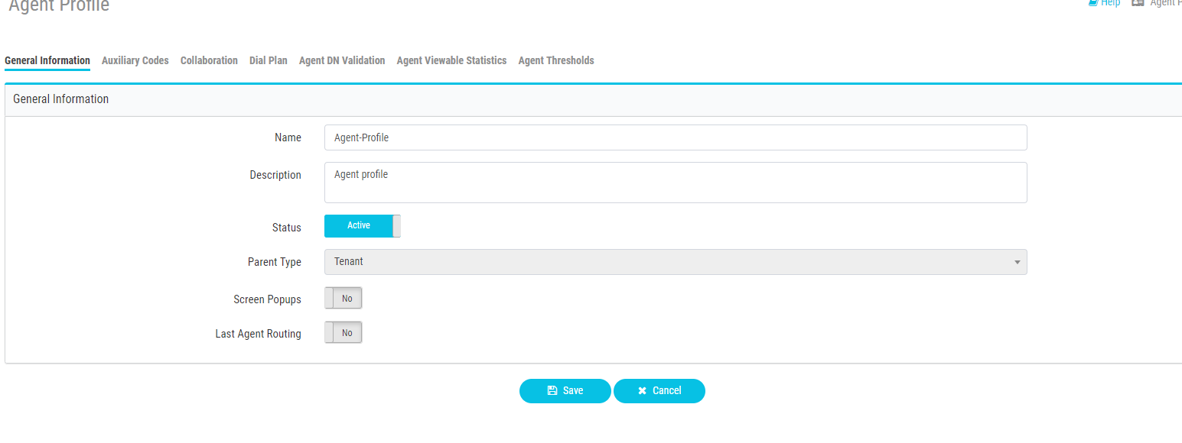
Provisioning – Agent Profiles
Manage Agent Profiles
Collaboration settings to enable conference/transfer for selected queues if needed
Select agent’s available idle / wrapup codes
Enable Outdial if agent should have outdial capabilities
DN validation to restrict the agent’s DN to use at sign on

Slide 20
Provisioning – Aux codes
Idle code examples:
Meeting
Lunch
Break
Training
Wrap Up Code examples:
Sale
Product inquiry
Customer complaint
Agent access to the codes can be restricted in agent profile
Idle codes and wrap up codes can be modified to fit your business model if you wish to use them for reporting
Auto wrap up can also be assigned via the Agent auto wrap up profile

Slide 21
Dashboard Training and additional features

Slide 22

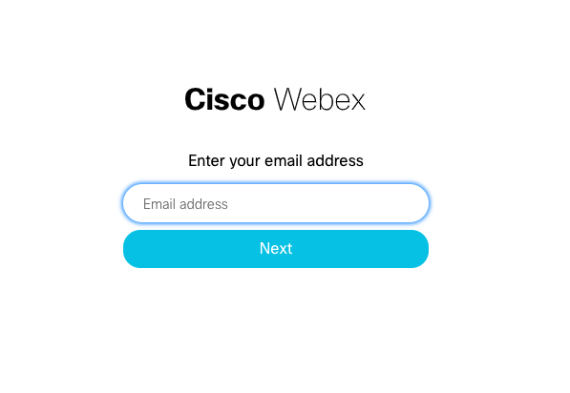
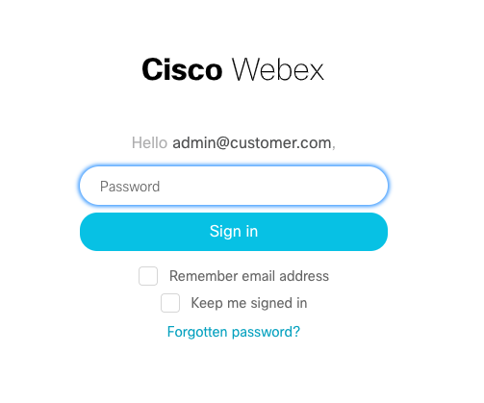
Login
CJP Portal can also be accessed using this URL: https://portal.cjp.cisco.com
Agent Desktop https://agent.cjp.cisco.com/ada-ws/home

Slide 23
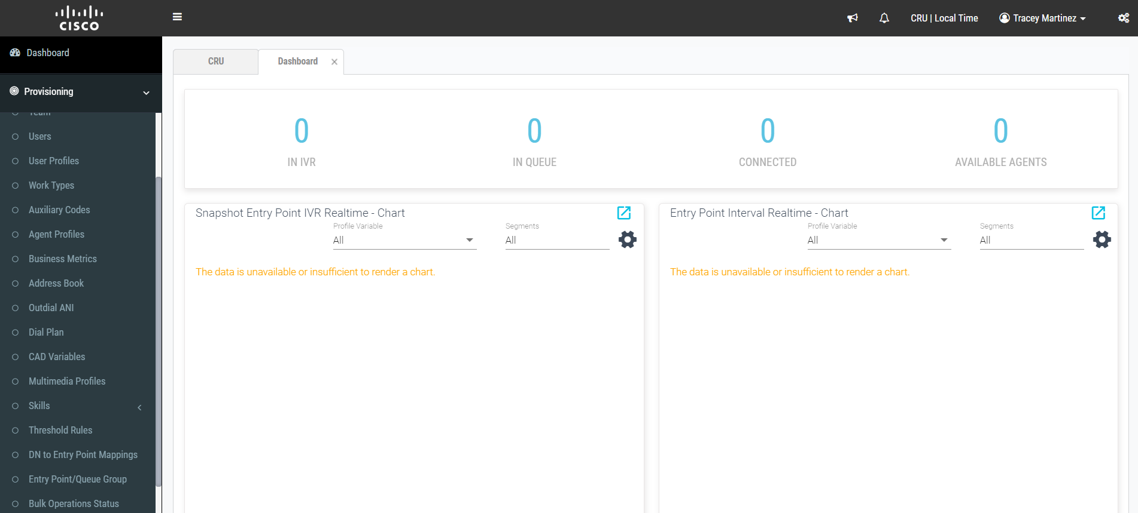
Management Dashboard Portal
XXX
XXX
Notes:
At this point do a walkthrough of each of the quadrants to explain what they are

Slide 24
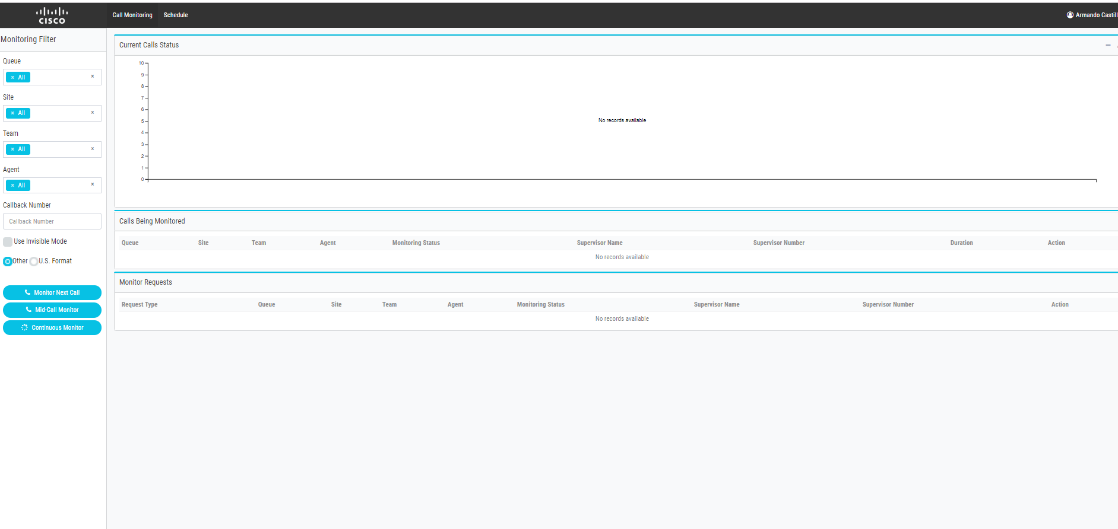
Call monitoring
Monitor next call
Mid call monitor
Continuous monitoring

Slide 25

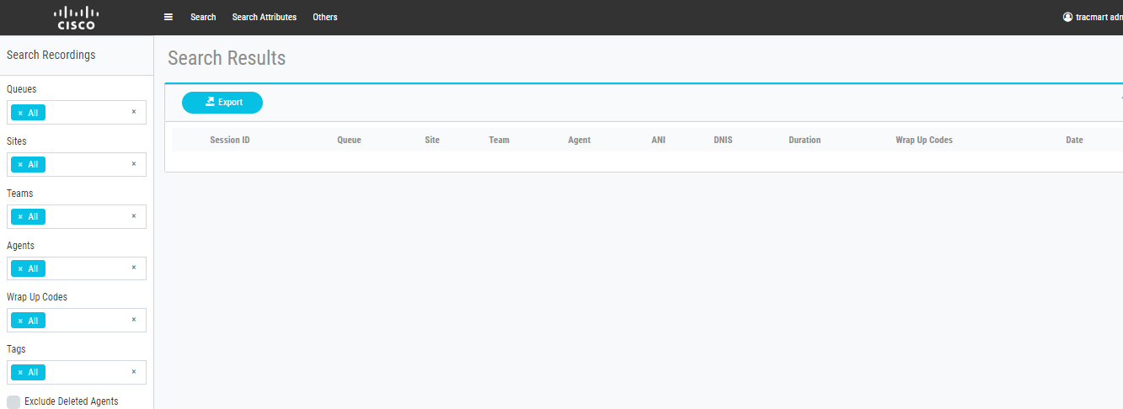
Call Recordings
Recording management>search recordings to playback
If tenant is set to record calls you can customize the recording schedule based on sites, teams or queues
Or tenant may be set to Record all calls
Call recording>New Schedule

Slide 26
Advanced Provisioning: Routing Strategies and Control Scripts

Slide 27
Routing Strategies
Routing strategies specify the system behavior
Time of day routing
Routing to teams
Both entry points and queues require routing strategies
RS for an EP must cover a 24hour period
A single entry point or queue may have more than one routing strategy (and typically does)
Closed, holidays, etc
As a supervisor you can turn an inactive RS to active for emergency purposes or inclement weather closures

Slide 28
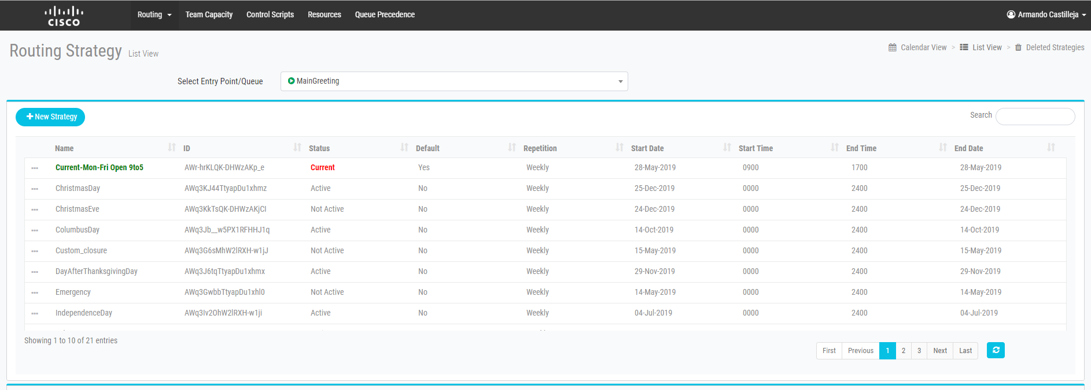
Current Routing Strategies
the current routing strategy is the active routing strategy
it is a working copy, created by the system, based on attributes such as status, default, start date, start time, etc
IMPORTANT: in order for changes to a routing strategy to take effect, you need to delete the current copy
a new current routing strategy will be created automatically, assuming an active routing strategy for that time period exists
the current routing strategy will be regenerated periodically

Slide 29
Routing Strategies
default routing strategies cannot overlap with one another
non-default routing strategies can overlap with default
non-default take precedence
non-default routing strategies cannot overlap with other non-default
Non-Default
Emergency Closed
Default
Closed AM
Open
Closed PM

Slide 30
Routing Strategies
Right
default
Closed AM
Open
Closed PM
Wrong
Open
default
Closed AM
Closed PM
default
Closed AM
Open
Closed PM

Slide 31
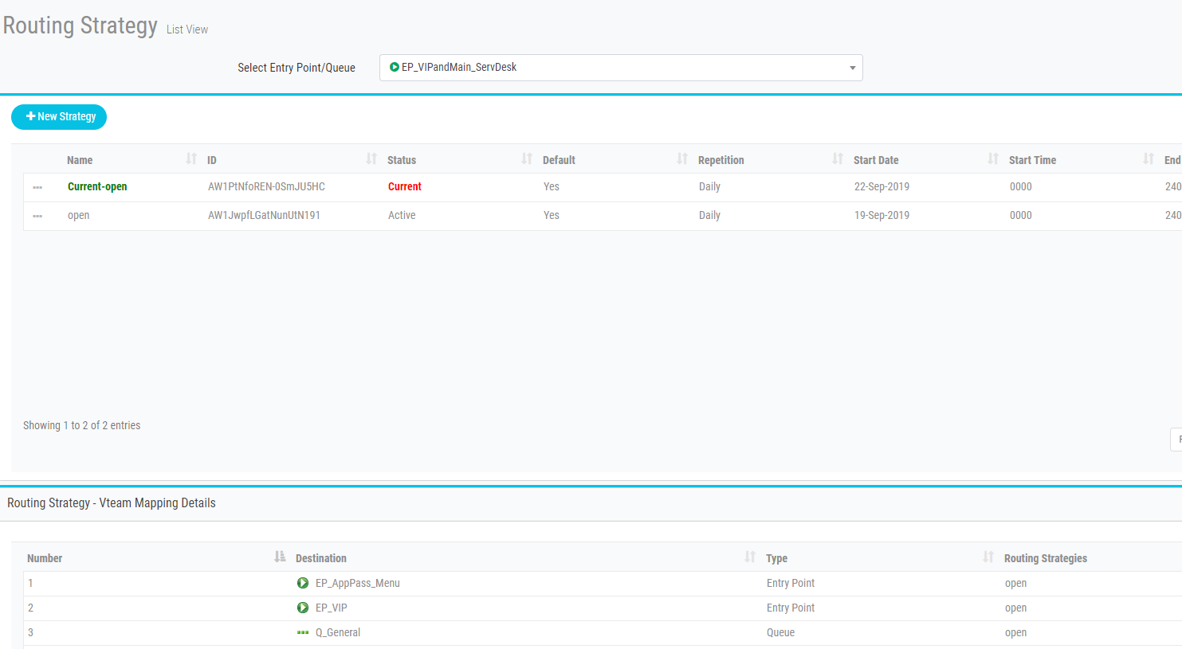
Routing Strategy – list view

Slide 32
Control Scripts
control behavior of entry points and queues
created by YOU/Customer, Cisco CSM,
or Professional Services
two files:
.js
uploaded to Dashboard > Routing Strategy > File Upload > Control Scripts
.php
uploaded to Dashboard > Routing Strategy > File Upload > Resources
once uploaded, may be used in multiple routing strategies
note: custom (PS-generated) control scripts may require additional configuration in order to function correctly

Slide 33
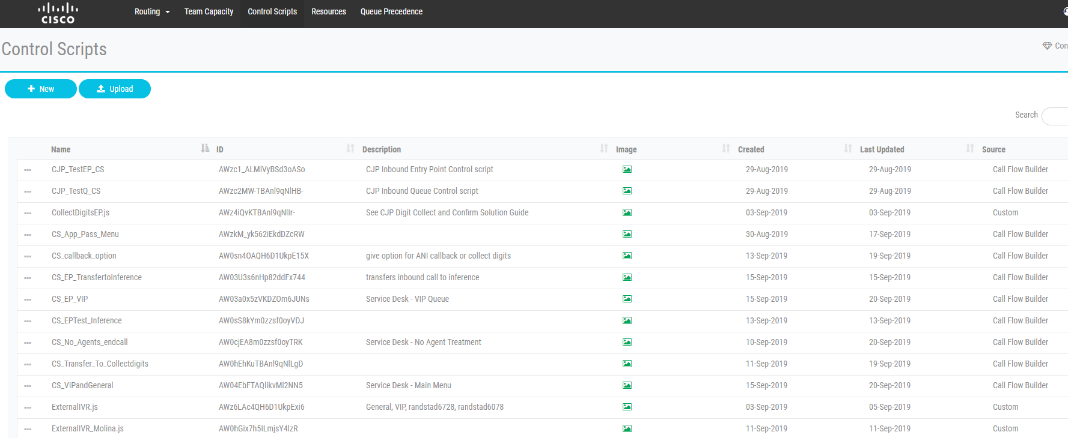
Call Flow Builder – Control Scripts Library

Slide 34
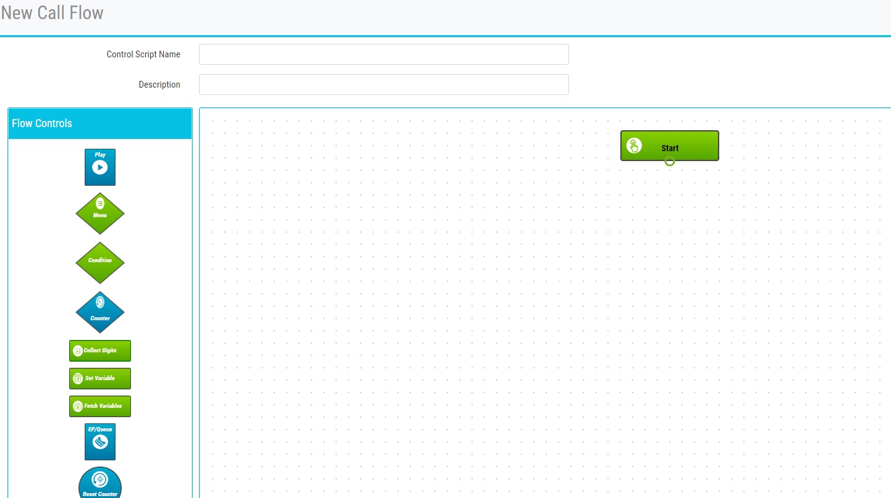
Creating Control Scripts
You can drag a flow control block from the panel to the canvas to add it to the call flow
Double-click on the flow control block and specify the required parameters in the dialog box that opens
For a description of each flow control block and it’s parameters - consult the online Help file

Slide 35
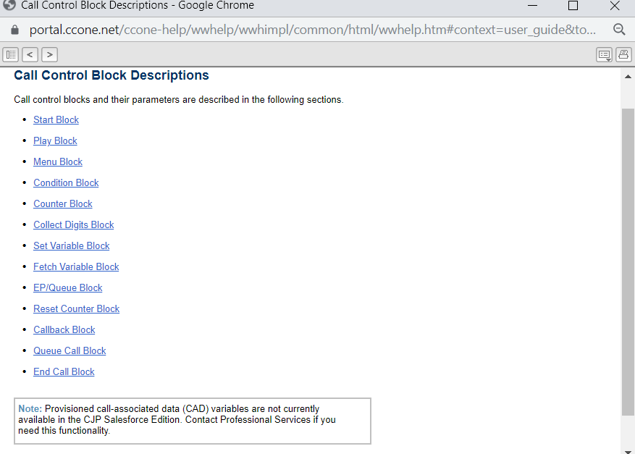
Control script online help

Slide 36


Message & Music Files (.WAV)

Slide 37

Audio files info
All audio files the caller hears within WxCC are in the format of a .wav file
Music on hold
IVR message
Closed messages
Message while on hold
All wav files are stored in application under Resources tab of RS
Routing Strategy>Resources
If supervisors/admins need to implement a new wav file, they need to upload it to the resources tab and then attach it to the correct RS
Use the following file format and settings:
wav: u-Law, 8.000 kHz. 64 Kbps, mono

Slide 38


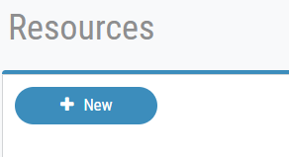
To upload a new wav file:
Go to the Routing Strategy tab from the Admin Portal
Open the Resources Tab
Click on the Add New resource
Browse to your files to attach the correct wav file
The wav file name will automatically populate when the file is attached.
IMPORTANT: Be sure there are no spaces in the wav file name. If there are the wav file will not be compatible and will cause an error

